Slide 1
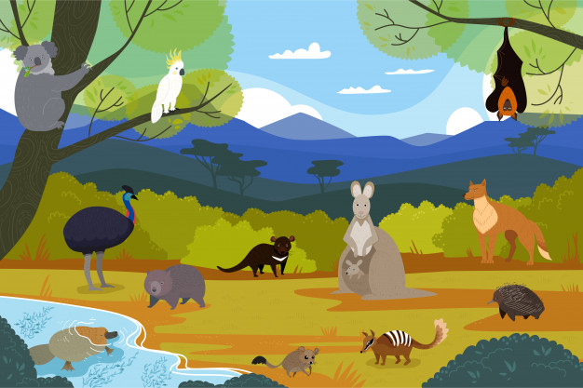
WILDLIFE IN AUSTRALIA
Isabelle Beaubreuil (ac. Limoges)

Slide 2

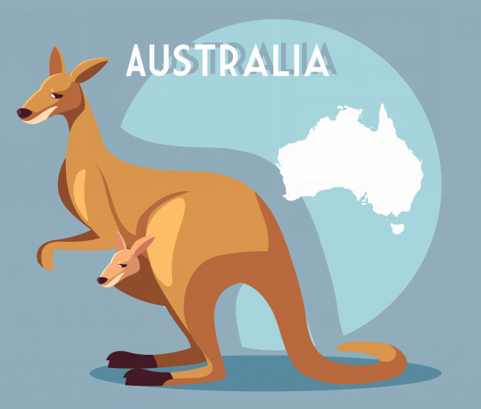
STEP 1
10'
BRAINSTORMING
WHAT DO YOU NOW ABOUT THIS AUSTRALIAN ANIMAL ?

Slide 3
STEP 1
BRAINSTORMING
WATCH A VIDEO AND COMPLETE YOUR NOTES

Slide 4
SPECIES
BODY / APPEARANCE
ACTIONS / ABILITIES
ADJECTIVES

Slide 5
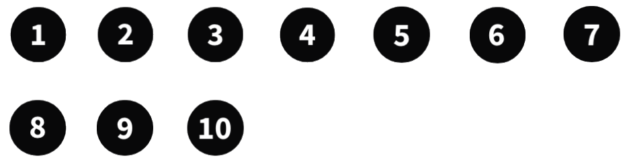
LESSON: FACTS ABOUT KANGAROOS
There are 44 million kangaroos in Australia and there are 55
different species.
Kangaroos are marsupials because the babies (called joeys)
develop in a pouch.
They live in groups and they eat grass. They are 2m tall.
They are speedy (= fast) because they can travel around
50km/h (fifty kilometres per hour).
They can hop (= jump) about 9m thanks to their powerful back
legs.
They have a long, strong tail and huge (= giant) feet.
They use them to kick their opponents or beat on the ground
when there is danger.

Slide 6

QUIZ TIME !

Slide 7


QUESTION 1
HOW MANY KANGAROOS ARE THERE IN AUSTRALIA ?
THIRTY-FIVE
FIFTY-FIVE
SIXTY-FIVE
SEVENTY-FIVE

Slide 8
QUESTION 2
WHY ARE KANGAROOS MARSUPIALS ?
BECAUSE
THEY HAVE A TAIL
BECAUSE
THEY CAN JUMP
BECAUSE
THE BABIES DEVELOP
IN A POUCH
BECAUSE
THEY LIKE MEAT

Slide 9
QUESTION 3
HOW TALL ARE KANGAROOS ?
2m
3m
4m
5m

Slide 10
QUESTION 4
WHAT DO KANGAROOS EAT ?
INSECTS
GRASS
RODENTS
(mice, rats, …)
FISH

Slide 11
QUESTION 5
HOW FAST CAN THEY TRAVEL ?
20km/h
30km/h
40km/h
50km/h

Slide 12
QUESTION 6
HOW ARE BABY KANGAROOS CALLED ?
CHANDLERS
ROSSES
JOEYS
GUNTHERS

Slide 13
QUESTION 7
THANKS TO WHAT PART OF THEIR BODY CAN THEY HOP ?
THEIR TAIL
THEIR FRONT LEGS
THEIR FEET
THEIR BACK LEGS

Slide 14
QUESTION 8
WHAT DO THEY DO WHEN THEY SENSE DANGER ?
THEY BEAT ON
THE GROUND
THEY HIDE
THEY HOP AWAY
THEY SCREAM

