Slide 1
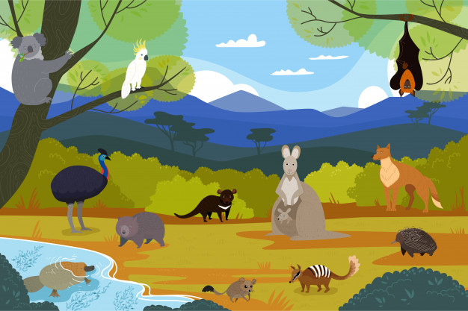
WILDLIFE IN AUSTRALIA
Isabelle Beaubreuil (ac. Limoges)

Slide 2
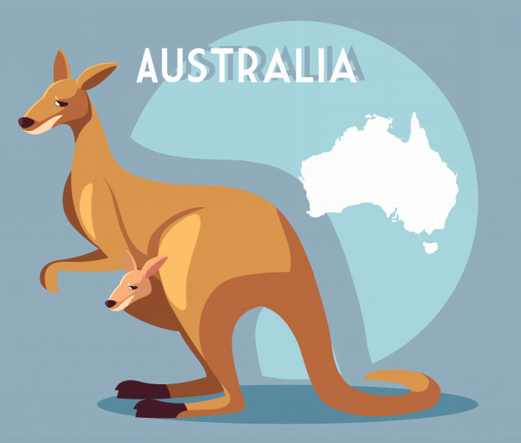
STEP 2
TALK ABOUT THIS ANIMAL

Slide 3
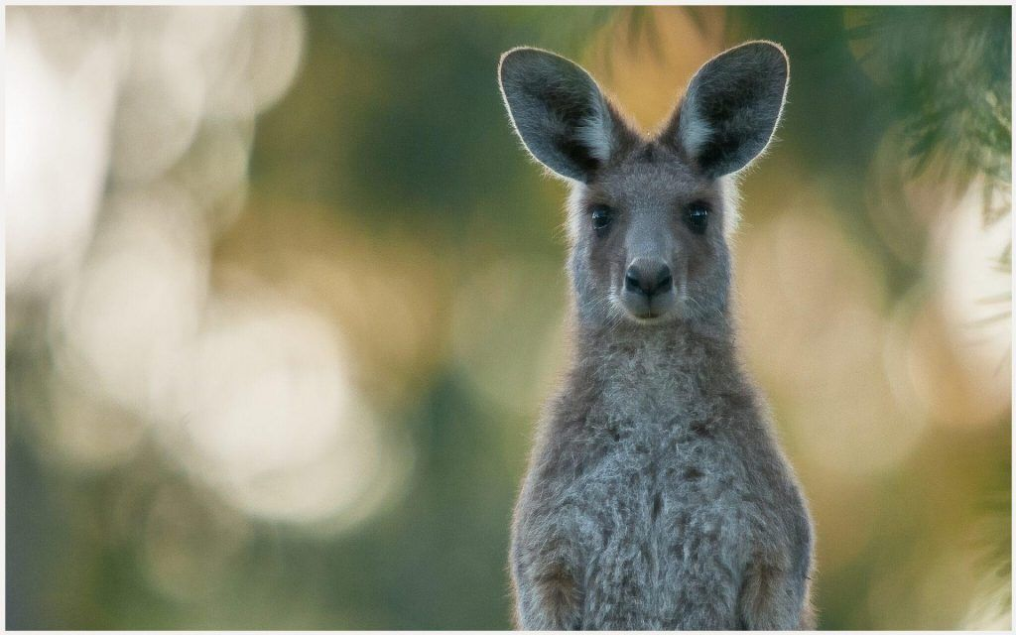
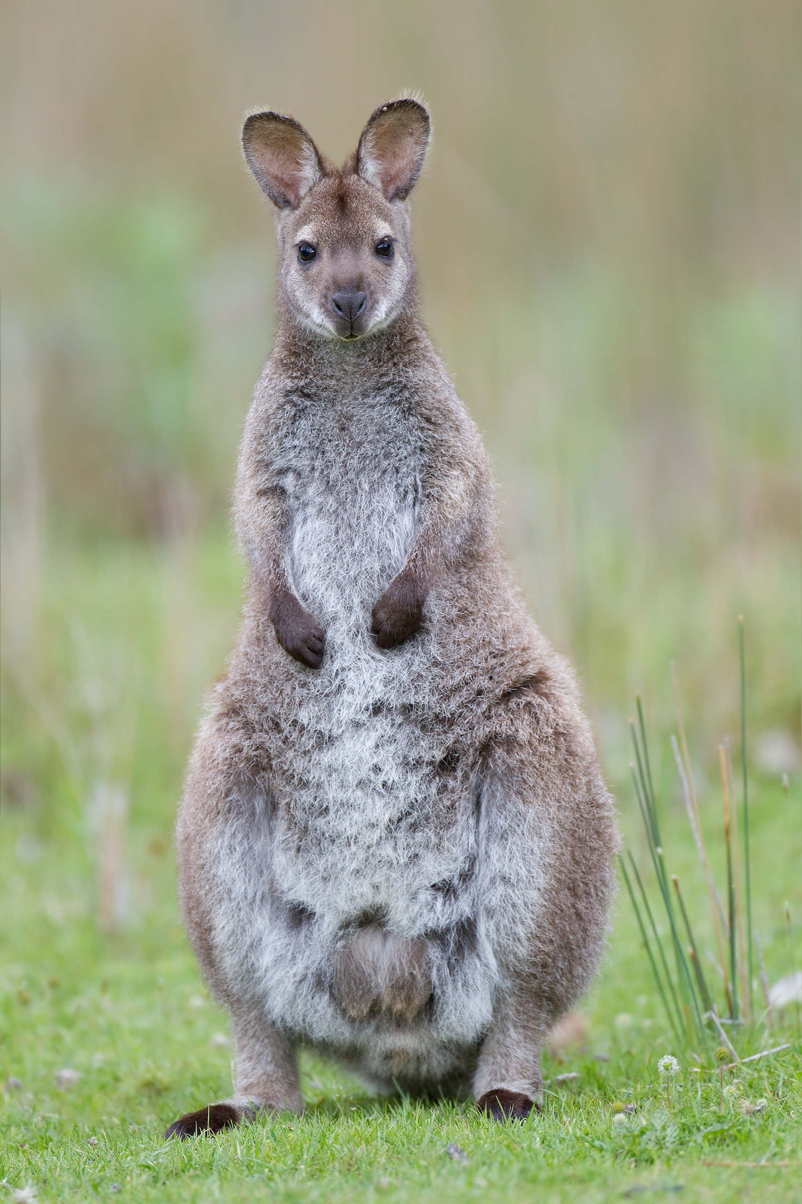
WATCH A VIDEO ABOUT THIS ANIMAL !

Slide 4
WHAT IS IT ?
A WALLABY

Slide 5
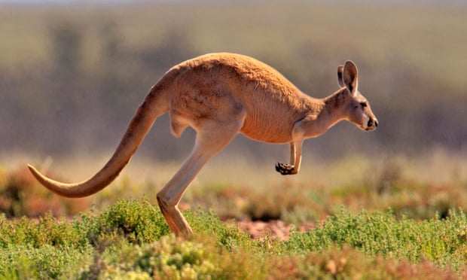
COMPARE THESE TWO ANIMALS !
WALLABIES
KANGAROOS

Slide 6
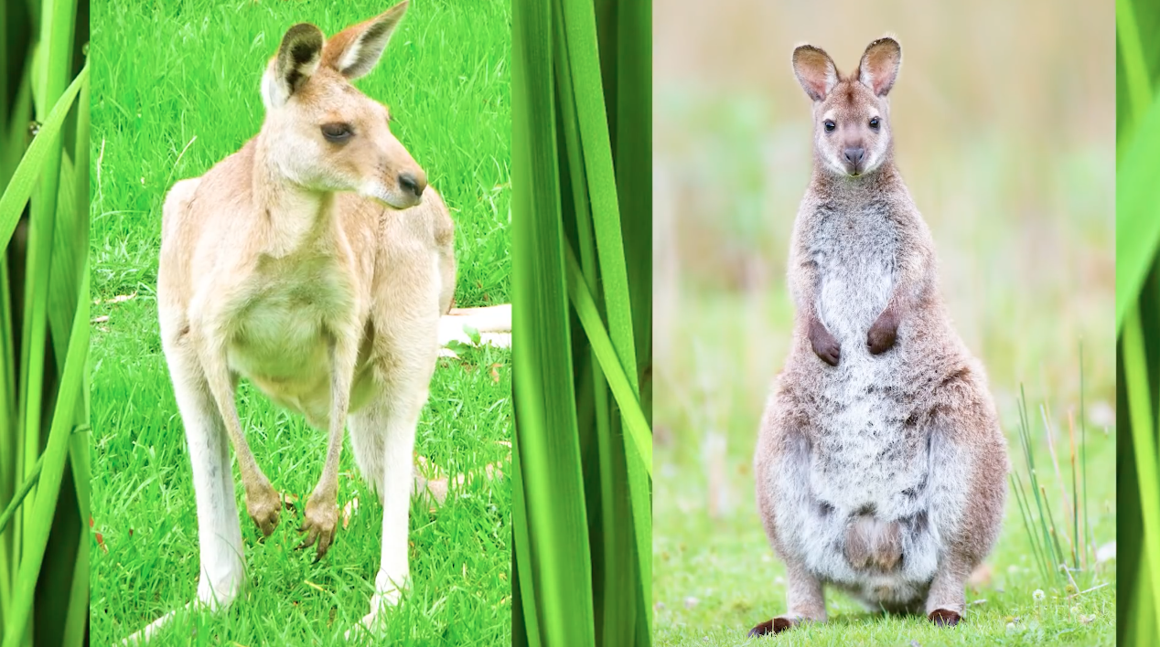
CORRECTION ET PROPOSITION DE TRACE ECRITE

Slide 7
COMPARE THESE TWO ANIMALS !
WALLABIES
KANGAROOS
smaller
taller
more compact / shorter legs
longer legs
faster
flatter teeth
brighter coats
more dull in colour
eat leaves from the forest
eat more grass in open areas

Slide 8
LESSON: WALLABIES AND KANGAROOS
Kangaroos and wallabies are marsupials.
--> Both kangaroos and wallabies are marsupials.
They have big feet.
--> Both have big feet.
Wallabies are smaller than kangaroos.
Kangaroos have longer legs, so they are faster.
Wallabies have more compact / shorter legs.
Wallabies have flatter teeth because they eat leaves.
Wallabies have brighter colours than kangaroos.

