Slide 1
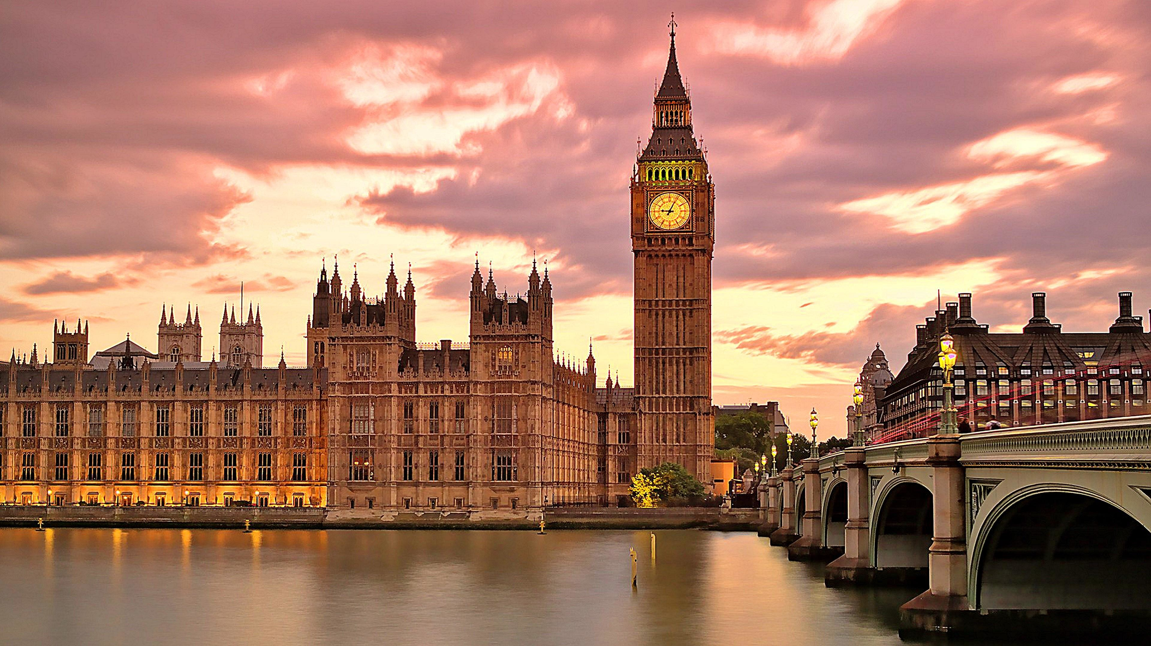
SEANCE 2

Slide 2

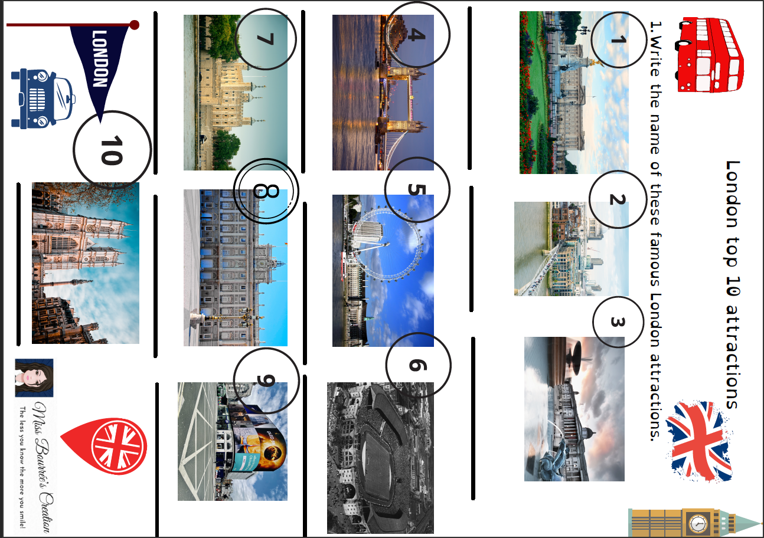
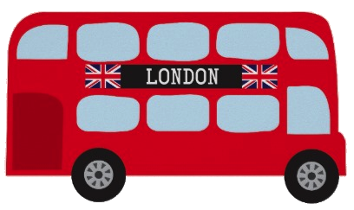
LONDON TOP 10 ATTRACTIONS

Slide 3
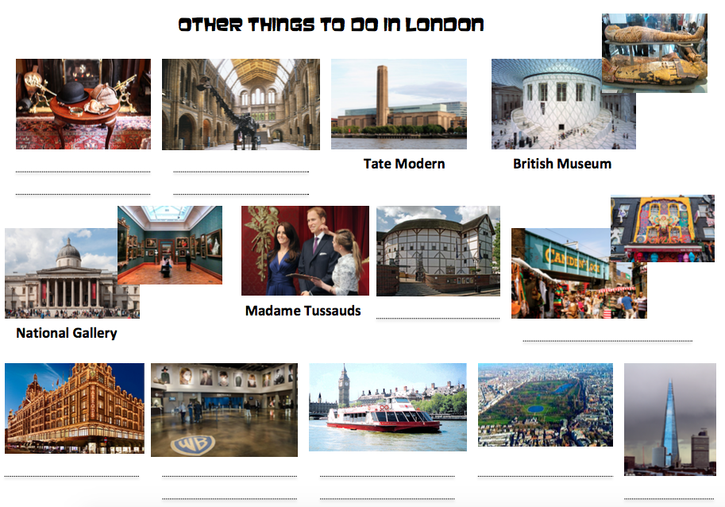
Sherlock Holmes
Museum
Natural History
Museum
The Globe
Camden Market
Harrods
The Warner Bros
Studios
The Thames
River Cruise
Hyde Park
The Shard

Slide 4

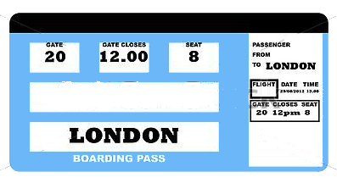
SPELLING BEE CONTEST
WIN A TRIP TO LONDON!

Slide 5
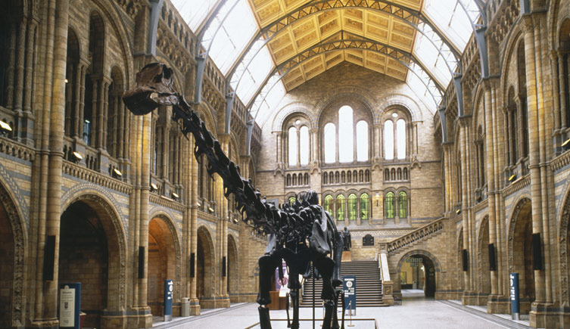


WHAT WILL YOU DO
IF YOU GO TO LONDON?
IF I GO TO LONDON,
I WILL VISIT THE NATURAL HISTORY MUSEUM
IN ORDER TO
SEE DINOSAUR SKELETONS.

Slide 6
IF I GO TO LONDON,
I WILL
Visit the Sherlock Holmes Museum | The Shard | Visit Westminster Abbey
Go to Wembley Stadium | Visit Madame Tussauds | Go to Harrods
Visit the British Museum | Go to the Warner Bros Studios | Go to Hyde Park
IN ORDER TO
Look at wax figures of celebrities | Visit the sets of Harry Potter | Attend a football match
Admire the view over London | See the coronation throne | See Egyptian mummies
Buy expensive souvenirs | Have a walk and relax | Learn about this famous detective

Slide 7
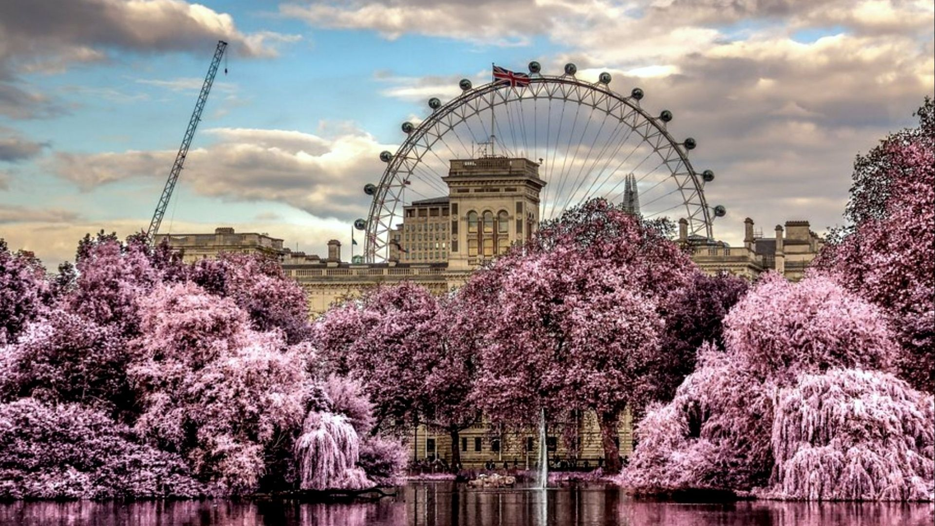
SEANCE 3

Slide 8
WHAT WILL YOU DO
IF YOU GO TO LONDON?
IF I GO TO LONDON,
I WILL ………………………………………
IN ORDER TO
………………………………………… .

Slide 9
SPELLING BEE CONTEST
CAN YOU SPELL ….
?
Group 1 |  | Group 4
Group 2 |  | Group 5
Group 3 |  | Group 6

